Slide 1
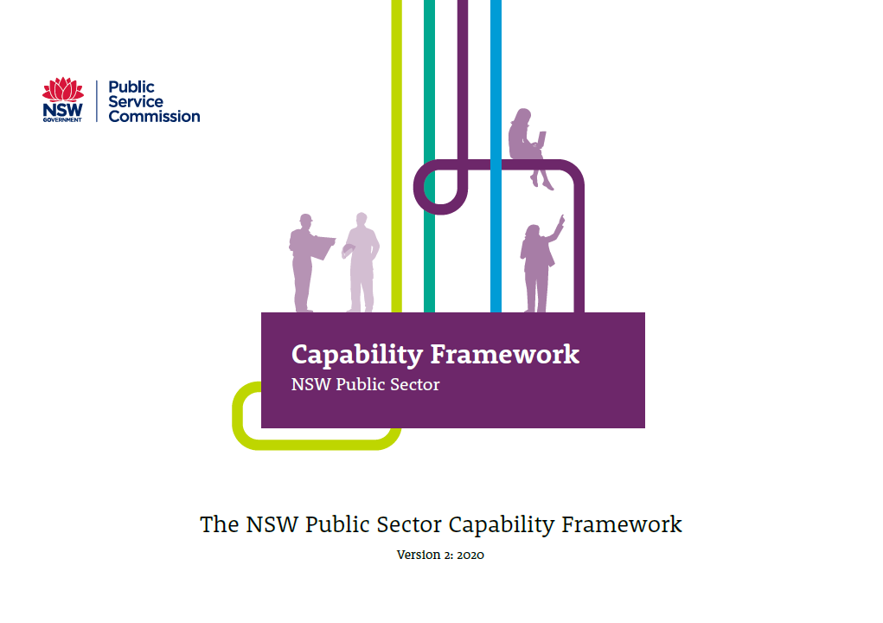
The NSW Public Sector Capability Framework

Slide 2
Capability Framework Overview
Describes the core knowledge, skills and abilities required of all public sector employees, across all levels and all occupational groups
Includes behavioural indicators across five levels, reflecting a progressive increase in capability
The five capability levels are foundational, intermediate, adept, advanced and highly advanced
Does not link capability levels to job classification or grade
Provides the public sector with a shared language to describe the capabilities needed to perform work effectively

Slide 3
Key features of the Capability Framework
A single, plain English resource that describes both executive and non-executive capabilities
Integrates elements of the Ethical Framework and the Public Sector Core Values
Includes the ‘Business Enablers’ group of non-specialist capabilities for ‘Finance’, ‘Technology’, ‘Procurement and Contract Management’ and ‘Project Management’
May be used in conjunction with complementary occupation specific capability sets

Slide 4
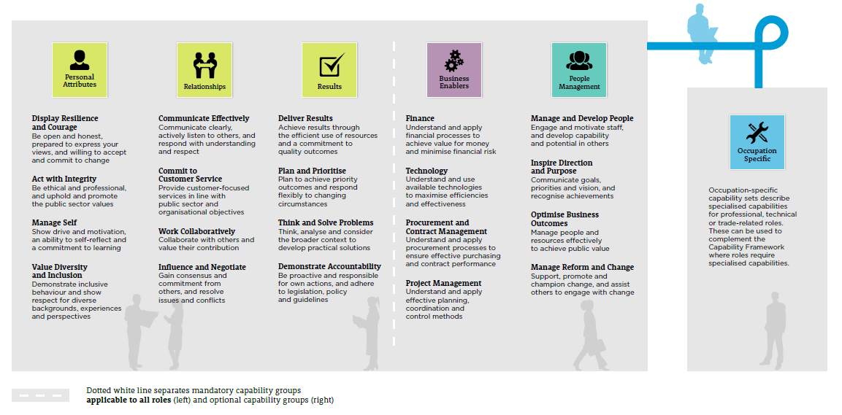
Capabilities & Occupation/profession specific capabilities

Slide 5
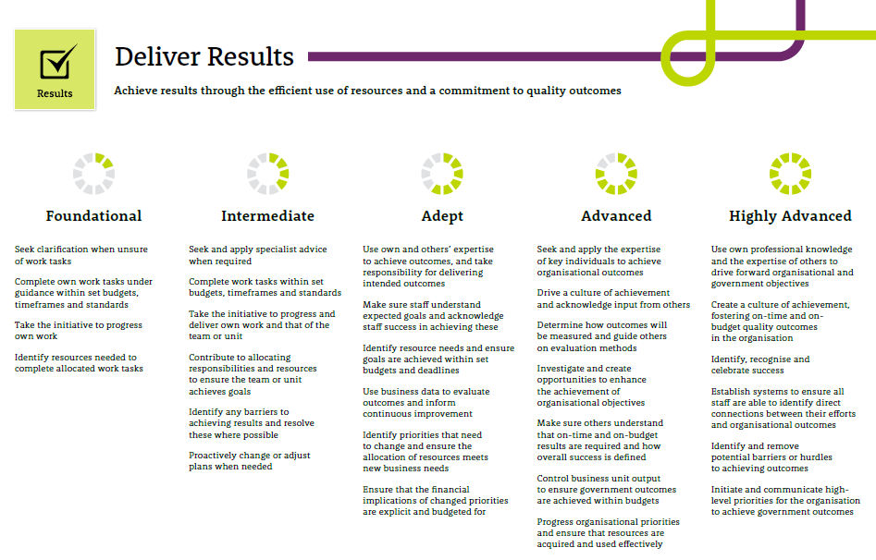
Behavioural Indicators
Example: Deliver Results
Behavioural indicators describe the type of behaviours expected for effective performance at that level
Behavioural indicators are indicative and provide a reasonable understanding of what a particular level of capability ‘looks like’
The listed behavioural indicators are not an exhaustive list
Notes:
Each capability has five levels, depicting a growing set of knowledge, skills and abilities in the capability area.
The degree of knowledge, skill and ability at each level is illustrated by the behavioural indicators. The behavioural indicators are indicative behaviours that illustrate effective performance.
The five levels do not correspond to a grade. Each role may require capabilities at different levels, depending on the nature of its functions.

Slide 6
Using the capabilities
The Capability Framework provides a foundation for the full range of workforce management and development activities:
role design and description
recruitment
performance management
learning and development
career pathing and mobility
reward and recognition
talent management
workforce planning
Notes:
Provides managers , staff and potential new employees with a common language in describing the core capability requirements
Assists recruitment selection panels to have a clear picture of the type and level of capabilities required and apply targeted assessment methodologies in filling a role
Supports employees to identify career and development pathways based on the capabilities required for progression to chosen roles
Assists managers and staff to staff to have a clear, common understanding of role expectations and discuss targeted development needs
Supports management to identify and plan for current and future workforce capability needs and gaps.

Slide 7
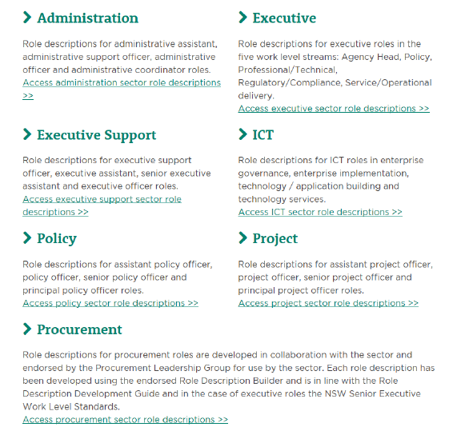
Sector role description library
Sector role descriptions are available for roles that are common across the sector, and are published in an online library
For more information refer to Sector Role Description Guide and FAQ’s
Notes:
Before starting a new role description check the Sector Role Description Library which contains role descriptions for a range of non-executive and executive roles that are common across the public sector. You may not need to create a new role description, sector role descriptions will save you much of the work involved in developing a role description.
When using a sector role description refer to the Sector Role Description Action Guide (PDF 99.1KB) to understand what customisation can be made and what sections should be retained unchanged. There is plenty of scope for customising the Sector Role Description to the individual agency context and to meet specific agency needs, although the pre-existing content of the Role Descriptions should remain fundamentally the same to maintain their value for role consistency and mobility
If existing Sector Role Descriptions do not adequately describe the role required, the agency may need to develop its own. In this case, refer to the Role Description Development Guideline as NSW Government role descriptions should be developed in line with this guide. You may also want to review the Capability Comparison Guide (PDF 85.1KB).

Slide 8
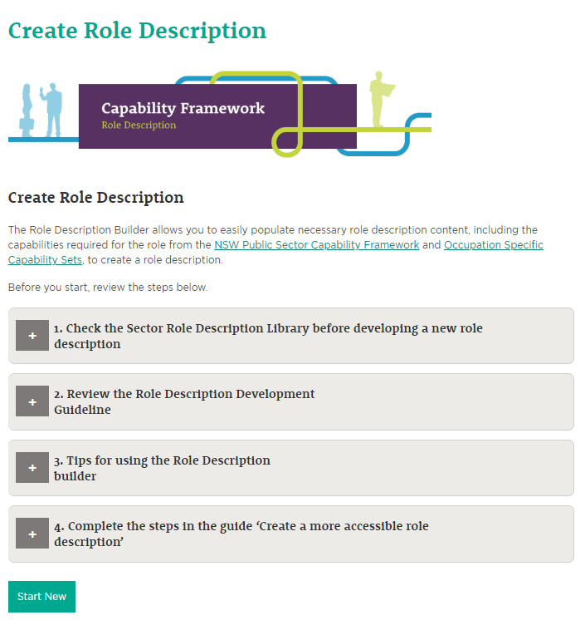
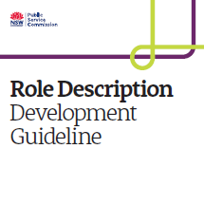
Developing new role descriptions
Create new role descriptions easily with the Role Description Builder
Role descriptions should be developed in line with the Role Description Development Guideline. An e-learning course is also available.
Notes:
The Role Description Builder is a tool to help users to create a new role description.
The tool allows users to easily populate necessary role description content, including the capabilities required for the role from the NSW Public Sector Capability Framework and Occupation Specific Capability Sets
Before starting a new role description check the Sector Role Description Library which contains role descriptions for a range of non-executive and executive roles that are common across the public sector. You may not need to create a new role description, sector role descriptions will save you much of the work involved in developing a role description.
When using a sector role description refer to the Sector Role Description Action Guide (PDF 99.1KB) to understand what customisation can be made and what sections should be retained unchanged. There is plenty of scope for customising the Sector Role Description to the individual agency context and to meet specific agency needs, although the pre-existing content of the Role Descriptions should remain fundamentally the same to maintain their value for role consistency and mobility
If existing Sector Role Descriptions do not adequately describe the role required, the agency may need to develop its own. In this case, refer to the Role Description Development Guideline as NSW Government role descriptions should be developed in line with this guide. You may also want to review the Capability Comparison Guide (PDF 85.1KB).

Slide 9
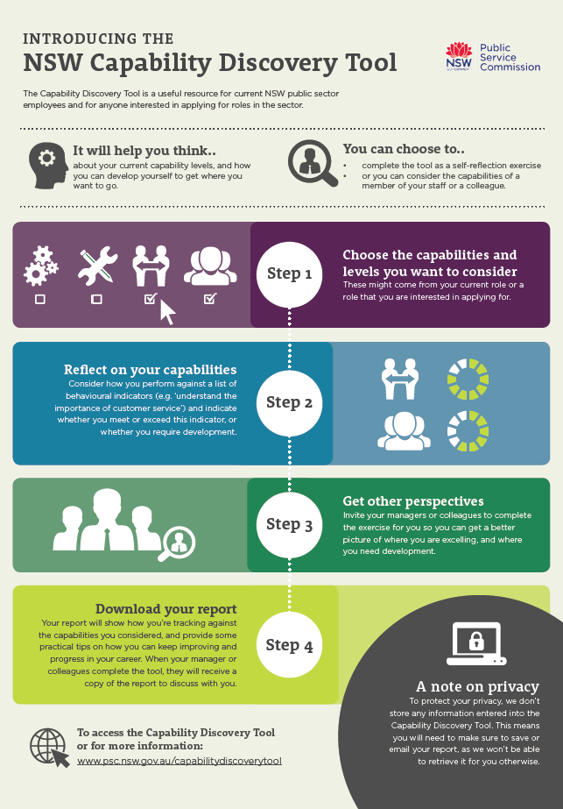
Capability Discovery Tool
The Capability Discovery Tool helps:
you to reflect on your capabilities and development needs
you to get others’ perspectives on your capabilities
you to discuss your development needs and career aspirations with your manager
anyone interested in applying for roles in the NSW government sector
Notes:
The Capability Discovery Tool will help you to reflect on your capabilities and development needs (or those of your staff).
It is a useful resource for both current NSW public sector employees and for anyone interested in applying for roles in the sector.
You can choose to complete the exercise as a self-assessment or you can assess a member of your staff or a colleague. You can also nominate other people, such as your manager, peers or colleagues, to complete the assessment on your behalf and provide you with feedback on your capabilities.

Slide 10
Further Information
If you have any questions about the
Capability Framework contact:
capabilityframework@psc.nsw.gov.au

