Slide 1
Considering workforce strategies
Tool for the ‘implement’ stage of the strategic workforce planning cycle

Slide 2

Goal of the Implement stage
Click to add pull-out text
  Second level
    Third level
      Fourth level
        Fifth level
          6
            7
              8
                9
Please note:
This tool has been developed to assist you with:
  Considering workforce options
  Building your plan
This is not a comprehensive tool for the Implement stage of the Strategic Workforce Planning cycle. These templates will assist you with certain aspects of the Implement stage. To learn about all the aspects of the Implement stage, register for the NSW Government Strategic Workforce Planning Masterclasses
Please note that you may not need to use all elements of this tool. You may tailor or modify the templates based on the needs and strategic workforce planning maturity of your organisation.
Additional information
If you need further information or would like to provide feedback, please contact the NSW Public Service Commission at swp@psc.nsw.gov.au
Identify actions to meet work and workforce requirements to achieve organisational goals and manage any associated risks.

Slide 3
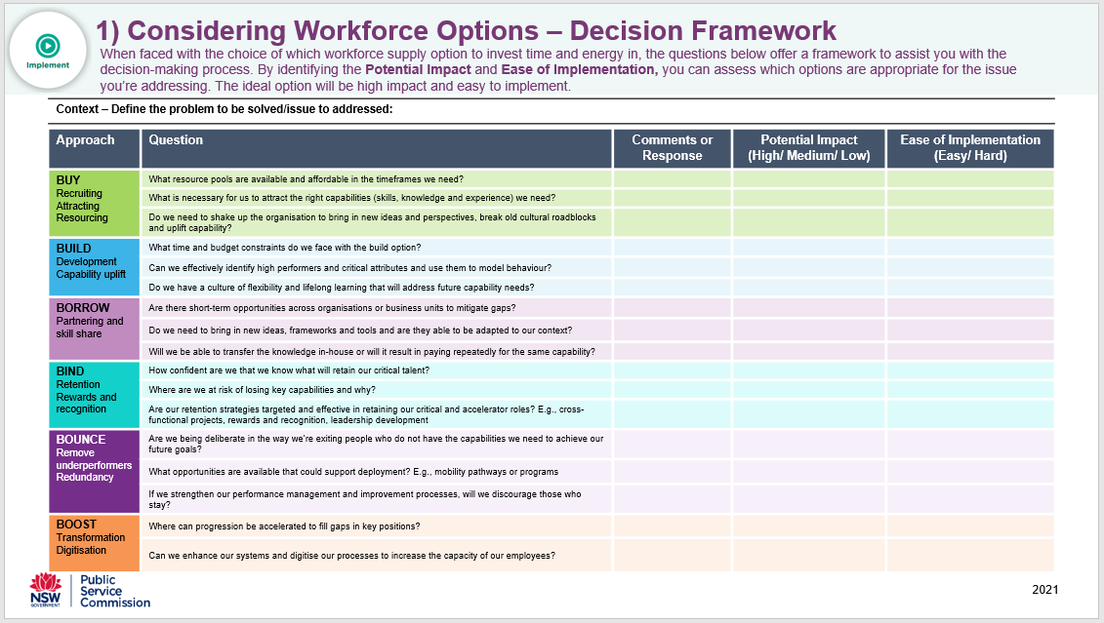
Considering workforce options – the 6 B's
In the Implement stage of the Strategic Workforce Planning cycle, we look at the diverse range of workforce strategies available to build the workforce we'll need in the future. The 6 B’s model refers to the range of workforce strategies available: Build, Buy, Borrow, Bind, Bounce, and Boost.
This tool gives a brief overview of each workforce strategy and provides you with a series of questions based on the 6 B’s to help you choose workforce strategies that have a positive impact and helps your organisation achieve its’ strategic objectives.
  Tips on how to use this tool
  Be objective and aware of any biases or assumptions you might have when asking yourself these questions
  This can be used as a discussion framework with your team and stakeholders, so you can agree on the right actions to take
  Note that the ease of implementation is about your capacity and capability – something that’s high impact might be hard to implement, but worth the investment because of the potential value and outcomes it will achieve

Slide 4
Options for workforce supply – the 6 B's
BUY
BIND
Recruit internally or externally
Talent pools, secondments
Workforce as referrers
Employee value proposition
Retain critical talent and capability
Success and reward levers
Actively reducing turnover Redeployment
BUILD
BOUNCE
Capability uplift
Learning and development
Cross skill, upskill and reskill
Promotion
Job shadowing and job swaps
Remove under performers
Redundancy
Early retirements
BORROW
BOOST
Outsource, co-source and in-source Project-based teams
Consultants
Joint ventures
Transformation to lift efficiency and productivity
Process review and change
Digitisation and technology
Robotics

Slide 5
1) Considering Workforce Options – Decision Framework
When faced with the choice of which workforce supply option to invest time and energy in, the questions below offer a framework to assist you with the decision-making process. By identifying the Potential Impact and Ease of Implementation, you can assess which options are appropriate for the issue you’re addressing. The ideal option will be high impact and easy to implement.
Context – Define the problem to be solved/issue to addressed:
Approach: Buy - Recruiting, attracting, resourcing
Question | Comments or Response | Potential Impact (High/ Medium/ Low) | Ease of Implementation (Easy/ Hard)
What resource pools are available and affordable in the timeframes we need?
What is necessary for us to attract the right capabilities (skills, knowledge and experience) we need?
Do we need to shake up the organisation to bring in new ideas and perspectives, break old cultural roadblocks and uplift capability?
Approach: Build - Development and capability uplift
Question | Comments or Response | Potential Impact (High/ Medium/ Low) | Ease of Implementation (Easy/ Hard)
What time and budget constraints do we face with the build option?
Can we effectively identify high performers and critical attributes and use them to model behaviour?
Do we have a culture of flexibility and lifelong learning that will address future capability needs?

Slide 6
1) Considering Workforce Options – Decision Framework (continued)
Approach: Borrow - Partnering and skill share
Question | Comments or Response | Potential Impact (High/ Medium/ Low) | Ease of Implementation (Easy/ Hard)
Are there short-term opportunities across organisations or business units to mitigate gaps?
Do we need to bring in new ideas, frameworks and tools and are they able to be adapted to our context?
Will we be able to transfer the knowledge in-house or will it result in paying repeatedly for the same capability?
Approach: Bind - Retention Rewards and recognition
Question | Comments or Response | Potential Impact (High/ Medium/ Low) | Ease of Implementation (Easy/ Hard)
How confident are we that we know what will retain our critical talent?
Where are we at risk of losing key capabilities and why?
Are our retention strategies targeted and effective in retaining our critical and accelerator roles? E.g., cross-functional projects, rewards and recognition, leadership development

Slide 7
1) Considering Workforce Options – Decision Framework (continued)
Approach: Bounce - Remove underperformers and redundancy
Question | Comments or Response | Potential Impact (High/ Medium/ Low) | Ease of Implementation (Easy/ Hard)
Are we being deliberate in the way we’re exiting people who do not have the capabilities we need to achieve our future goals?
What opportunities are available that could support deployment? E.g., mobility pathways or programs
If we strengthen our performance management and improvement processes, will we be able to engage those who stay?
Approach: Boost – Transformation digitisation
Question | Comments or Response | Potential Impact (High/ Medium/ Low) | Ease of Implementation (Easy/ Hard)
Where can progression be accelerated to fill gaps in key positions?
Can we enhance our systems and digitise our processes to increase the capacity of our employees?

Slide 8
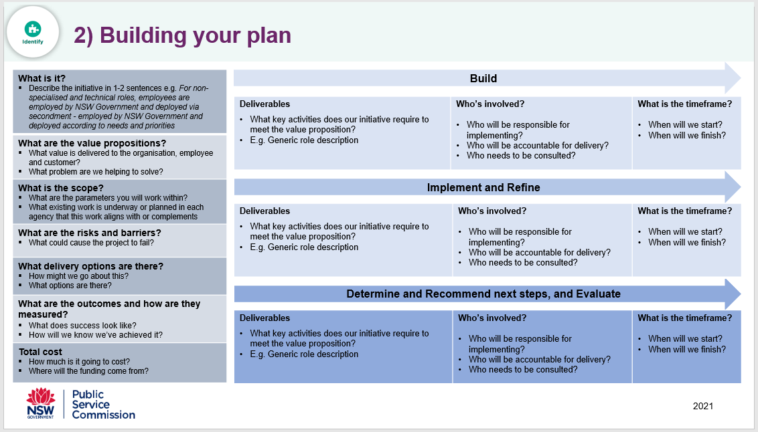
2) Building your plan
Once we’ve reached the Implement stage of the Strategic Workforce Planning cycle, we are ready to build and implement the plan. In this stage, we need to determine the best way to close the workforce gaps we’ve identified and ensure that the strategic workforce planning initiatives we’ve developed are targeted and measurable, and that tangible actions are outlined and allocated to the relevant individual/team.
The tool below has been designed to assist you with developing your approach by identifying the scope, risks, costs and outcomes of each strategic workforce planning initiative.
  Tips on how to use this tool
  Make sure you regularly consult and engage stakeholders across the business to ensure you receive feedback on your approach
  Make sure to build accountability, test commitment and review the feasibility of initiatives during implementation
  When listing the deliverables, stakeholders and timeframes for each initiative, it’s important to focus on tangible and a manageable number of actions, that will have positive short and long-term impacts on the workforce

Slide 9
2) Building your plan tool
What is it? Describe the initiative in 1-2 sentences e.g. For non-specialised and technical roles, employees are employed by NSW Government and deployed via secondment - employed by NSW Government and deployed according to needs and priorities
What are the value propositions? What value is delivered to the organisation, employee and customer? What problem are we helping to solve?
What is the scope? What are the parameters you will work within? What existing work is underway or planned in each agency that this work aligns with or complements?
What are the risks and barriers? What could cause the project to fail?
What delivery options are there? How might we go about this? What options are there?
What are the outcomes and how are they measured? What does success look like? How will we know we’ve achieved it?
Total cost How much is it going to cost? Where will the funding come from?
Overview of the Strategic Workforce Plan
Deliverables What key activities does our initiative require to meet the value proposition? E.g. Generic role description | Who’s involved? Who will be responsible for implementing? Who will be accountable for delivery? Who needs to be consulted? | What’s the timeframe? When will we start? When will we finish? What are the key milestones?
Implement and Refine
Deliverables What key activities does our initiative require to meet the value proposition? E.g. Generic role description | Who’s involved? Who will be responsible for implementing? Who will be accountable for delivery? Who needs to be consulted? | What’s the timeframe? When will we start? When will we finish? What are the key milestones?
Determine and Recommend next steps, and Evaluate
Deliverables What key activities does our initiative require to meet the value proposition? E.g. Generic role description | Who’s involved? Who will be responsible for implementing? Who will be accountable for delivery? Who needs to be consulted? | What’s the timeframe? When will we start? When will we finish? What are the key milestones?

Slide 10


Resources
For more inspiration on the Implement stage of the Strategic Workforce Planning cycle, listen to the following recordings from the SWP Accelerator Workshop Series:
Winning the case for change with Catherine Grummer, Chief Corporate Services Officer at TAFE NSW
Assessing the choices in workforce strategy options with Jaye Matheson, Director of Workforce Strategy at PwC
Join our LinkedIn group → NSW Government Strategic Workforce Planning Community
Register for our NSW Government Strategic Workforce Planning Masterclass

