Slide 1

Role descriptions
NSW Public Sector

Slide 2
What is a role description?
Gives clear and practical information about a role
Purpose
Deliverables
Context (organisational and occupational)
Challenges and interactions
Sets out the standards for a role:
Knowledge and experience
Capabilities (focus and complementary)
Explains a role’s:
Essential requirements

Slide 3
What is a role description used for?
Designing and
filling roles
Setting assessment standards
On the job
Identifying learning and development activities
Planning career development and progression
Informing performance agreements and reviews
Job evaluation
Explaining the role to employees, managers and candidates

Slide 4
Types of role descriptions
Sector role descriptions
For common roles across the sector
Save time
Are quality-assured
Assist with mobility
Improve consistency in grading and managing roles
See: PSC Sector role description library
Agency role descriptions
Can be for common roles or specialised or one-off roles
Role Description Development Guidelines give advice on creating RDs
Role Description Builder steps through RD development process
Capability Comparison Guide helps choose capability levels and focus capabilities

Slide 5
How to create a role description
Start with good job design
    refer to the Recruitment and selection guide – Doing a role analysis
Check the PSC Sector Role Description Library for a role description that:
    fits the role
    could be used with minor changes
Alternatively, create a new role description:
    use the Role Description Builder
    refer to the Role Description Development Guidelines

Slide 6
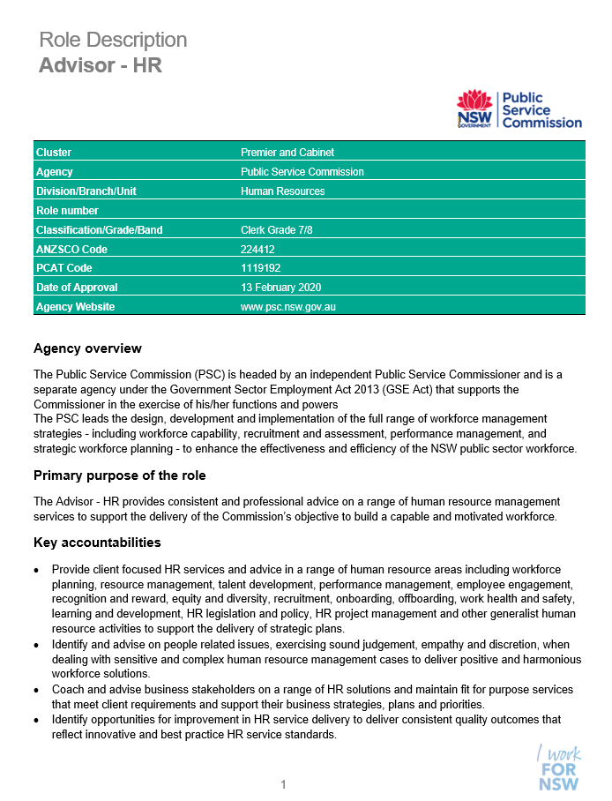
About the role description template
The RD template:
Ensures necessary information is included in a role description
Brings consistency to NSW public sector role descriptions in:
    How they look
    What they contain
Is customisable
Is supported by:
    Role Description Development Guidelines
    Role Description Builder

Slide 7
Role description template: Key details about role
Role information
Include key information about the role
When using the RD builder, fields marked with an asterisk ( * ) are mandatory
Mandatory fields in the role information are used in the Workforce Profile data collection
[include screen shot from RD builder – note RD example doesn’t show mandatory fields]

Slide 8
Role description template: Explanation of agency and role
Department / Agency overview
    Include short statement about the agency
Primary purpose of the role *
    Explain why the role exists
Key Accountabilities *
    Describe outcomes to deliver
    Do not list tasks
    Include up to 8 key accountabilities
Key Challenges *
    Describe major complexities faced
    Include 2-3 key challenges
Key Relationships *
    List stakeholders, customers (regular contact)
Role dimensions
    Describe where the role sits in the organisation
    Consider decision-making responsibilities, reporting line, direct reports and budget
Note: Fields marked with an asterisk ( * ) are mandatory

Slide 9
Role description template
Key Knowledge and Experience (K&E)
Include when:
    Needed for successful performance in the role
    Not captured in the capabilities for the role
    Cannot be developed on the job in a reasonable amount of time
Consider:
    Including in job ad rather than in the RD
    Potential for transfer of K&E
  K&E in the RD form part of the standards for the role and must be assessed in comparative or suitability assessment
Essential requirements
Without these things a person could not carry out the functions of the role
For example:
    Solicitors practising law in NSW must hold an Australian practising certificate
    The appropriate class of driver’s licence, if the role requires driving

Slide 10
Role description template: Capabilities
Focus capabilities
The capabilities decided to be most important for effective performance of the role
Should apply at least 1 capability from:
    Personal Attributes
    Relationships
    Results
    People Management (if applicable)
  May apply capabilities from:
    Business Enablers
    Occupation-specific capability set
  Must be assessed at recruitment
Complementary capabilities
Important to performing the role
Contribute to employee development and career planning
May apply to capabilities from:
    Capability Framework
    Occupation-specific capability set
  Not necessarily assessed at recruitment
  Capabilities that are ‘not essential’
  Capabilities from the Business Enablers group only that are not required to perform the role.
  Listed in the RD for development and career planning

Slide 11

Role description template: Capability levels
Capability levels show a progressive increase in complexity and skill from foundational to highly advanced
Consider the spread of capability levels:
    Should generally not exceed 3 consecutive levels
    Some roles may only need capabilities across two consecutive levels
The Capability Comparison Guide helps decide capability levels and focus capabilities
Capability levels do not determine grade of the role

Slide 12
Resources
Role Description Builder
Sector Role Description Library
Sector Role Description FAQs
Role Description Development Guidelines
Capability Comparison Guide
NSW Public Sector Capability Framework
Occupation-Specific Capability Sets
Recruitment and selection guide
Visit:
Role description resources index for
RD resources
Capability in the NSW public sector for Capability Framework resources
Recruitment and selection guide for recruitment information
Enquiries:
capabilityframework@psc.nsw.gov.au

