Slide 1
ICT occupation specific capability set (Skills Framework for the Information Age - SFIA)
An introduction

Slide 2
Contents of this Guide
Background overview and key features of the NSW Public Sector Capability Framework (the Capability Framework) and the ICT occupation specific capability set (SFIA)
Features of the Capability Framework
Features of the SFIA
How the Capability Framework and SFIA work together
Applying SFIA to role descriptions
Accessing SFIA

Slide 3
Background
The NSW Public Service Commission has an accredited partner licence to use the Skills Framework for the Information Age (SFIA) as the sector’s ICT occupation specific capability set.
The SFIA is intended to be used in conjunction with the NSW Public Sector Capability Framework (“Capability Framework”) to support the full range of workforce management and development activities, including role design and description; recruitment; performance development, learning and development; and strategic workforce planning.

Slide 4
The Capability Framework
The Capability Framework applies to all public sector roles, both executive and non-executive. Every role requires, at an appropriate level, all of the capabilities in the Capability Framework, including the Technology ‘Business Enabler’ and also the People Management capabilities for roles responsible for managing others.

Slide 5
Overview of the Capability Framework
The Capability Framework:
Describes the core knowledge, skills and abilities required of all NSW Public Sector employees, across all levels and occupations
Describes in Plain English, both executive and non-executive capabilities
Describes each capability across progressive levels

Slide 6
Overview of the Capability Framework
The Capability Framework:
Reflects the Government Sector Core values
Allows for complementary occupation or profession specific capability sets to be used in conjunction with the Capability Framework
Does not link capability levels to job classification or grade

Slide 7
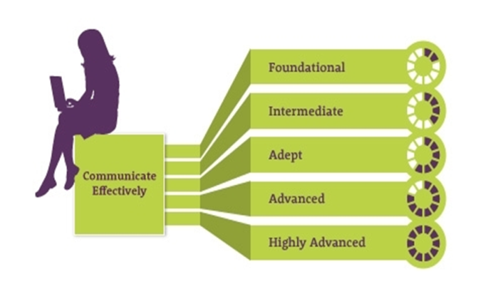
Capability Groups
16 core capabilities across four groups
Four additional capabilities for those roles
responsible for managing others

Slide 8
Capabilities and occupation/profession specific capabilities
Display Resilience and Courage | Communicate Effectively | Deliver Results | Finance | Manage and Develop People
Act with Integrity | Commit to Customer Service | Plan and Prioritise | Technology | Inspire Direction and Purpose
Manage Self | Work Collaboratively | Think and Solve Problems | Procurement and Contract Management | Optimise Business Outcomes
Value Diversity | Influence and Negotiate | Demonstrate Accountability | Project Management | Manage Reform and Change
ICT occupation specific capability set (SFIA)
Finance Professionals Capability Set
Procurement Professionals Capability Set

Slide 9
Background on the Skills Framework for the Information Age (SFIA)
The Skills Framework for the Information Age (SFIA) is a globally recognised framework used in over 100 countries
The ICT Leadership Group endorsed SFIA as fit for use in the NSW Public Sector in 2012
The Capability Framework and the SFIA has been progressively implemented by a number of agencies via the suite of ICT Sector Role Descriptions

Slide 10
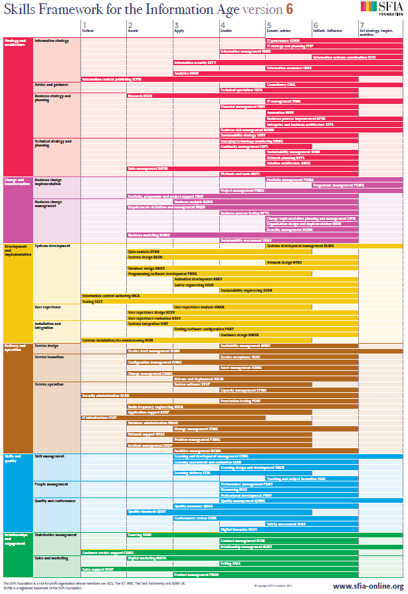
The SFIA at a glance
SFIA comprises 97 skills across 6 categories:
Strategy and architecture
Change and transformation
Development and implementation
Delivery and operation
Skills and quality
Relationships and engagement

Slide 11
SFIA levels
Each skill entry comprises an overall definition and descriptions of up to seven levels at which the skill might be exercised
The seven levels of capability do not apply to all skills, reflecting that some skills are required at entry level, while others kick in at more senior roles.

Slide 12
How the Capability Framework and SFIA work together
The SFIA is a stand-alone Framework; it comprises 97 skills, many of which are effectively described in the Capability Framework.
To avoid duplication, where a skill appears in the SFIA and the Capability Framework, the core capabilities should take precedence.
For example, skills contained in the SFIA that are adequately covered by capabilities from the Capability Framework, include:
IT Strategy and Planning described by the capabilities: Plan and Prioritise, Inspire Direction and Purpose, Work Collaboratively and Communicate Effectively.
Performance Management described by the capabilities: Manage and Develop People and Optimise Business Outcomes.

Slide 13
Applying SFIA in role descriptions
When does SFIA apply in role descriptions? | The SFIA applies when: the work clearly requires specialised ICT knowledge, skill and/or ability the specialised ICT work occupies a large part of the role the job title is strongly associated with the profession, e.g. Systems Administrator, Enterprise Architect the ‘Primary Purpose’, ‘Key Accountabilities’ and ‘Key Challenges’ contained in the role description indicate a need for ICT capabilities for successful performance of the role
How many SFIA skills apply? | Generally a small subset of capabilities will apply Most roles will require between 3 – 5 SFIA skills The spread of capability levels for a role should not generally exceed three SFIA levels
At what level does SFIA apply? | The levels in SFIA do not correspond directly to classifications or grades SFIA will generally only apply to roles above entry level but below agency head A SFIA Capability Comparison Guide is available that provides an indication of the number of SFIA capability levels (as a range) and an outline of the number of focus capabilities (as a range) at each Clerk Grade/Public Service Senior Executive Band
What about other role requirements, does SFIA describe these? | SFIA describes behaviours, not qualifications. If a qualification, professional membership or certification for a particular product or technology is an essential requirement for the role, this remains a prerequisite for employment and should be reflected in the “Essential Requirements” section of the role description

Slide 14
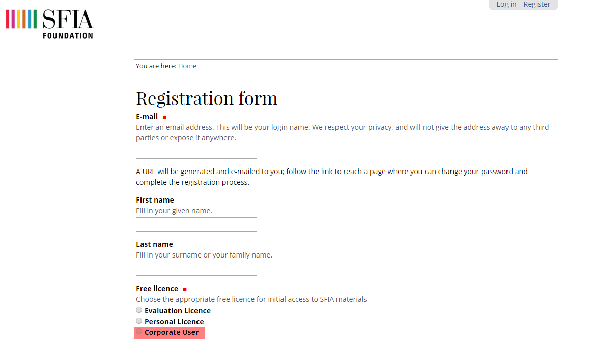
Accessing SFIA
The SFIA Framework can be accessed via the SFIA Foundation website. Users should register as a corporate user, via their NSW Government email address

Slide 15
More information
For more information go to:
Capability Framework
ICT Occupation Specific Capability Set (Skills Framework for the Information Age – SFIA) Introductory Guide
SFIA Level Capability Comparison Guide
SFIA Foundation website
Sector role description library
Or contact: capabilityframework@psc.nsw.gov.au

