Slide 1
NSW Public Sector
Occupation Specific Capability Sets

Slide 2
What are occupation specific capability (OSC) sets?
Occupational specific capability sets (OSCS) have been developed for specialist job families that are common in the sector
OSCS provide a consistent description of the unique capabilities required for roles in specific professions
OSCS, together with the NSW Public Sector Capability Framework (Capability Framework), provide a holistic picture of the knowledge, skills and abilities required for roles in these job families

Slide 3
Reasons for developing occupation specific capability sets
Support workforce management activities e.g. role design and descriptions; recruitment; performance development; learning and development and strategic workforce planning
Encourage employees to take control of their professional development and build their own career through both lateral and promotional opportunities

Slide 4
NSW Public Sector Capability Framework
Display Resilience and Courage | Communicate Effectively | Deliver Results | Finance | Manage and Develop People
Act with Integrity | Commit to Customer Service | Plan and Prioritise | Technology | Inspire Direction and Purpose
Manage Self | Work Collaboratively | Think and Solve Problems | Procurement and Contract Management | Optimise Business Outcomes | e.g. ICT, HR, Finance, Legal, Procurement
Value Diversity | Influence and Negotiate | Demonstrate Accountability | Project Management | Manage Reform and Change

Slide 5
Current sector wide occupational specific capability sets
Information &
Communications Technology

Slide 6
General principles
OSC are requirements that are unique to the occupation and are ‘additional to’, rather than ‘instead of’, the public sector capabilities
That is, occupation specific capability sets are used in conjunction with the NSW Public Sector Capability Framework
Notes:
Where occupation/profession specific capabilities overlap with the NSW Public Sector Capability Framework, the Public Sector capabilities should be used to maximise consistency across the sector.
Agencies may use occupation/profession specific capability sets that have been internally developed to meet local needs, or access externally developed frameworks, for example, cross-jurisdictional standards or those offered by professional associations in conjunction with the NSW Public Sector Capability Framework.

Slide 7
About behavioural indicators
Behavioural indicators describe the type of behaviours expected for effective performance at each level for each capability
Behavioural indicators are indicative, rather than exhaustive and some listed behaviours may not be relevant to a particular role
Behavioural indicators provide a reasonable picture of what a particular level of capability ‘looks like’

Slide 8
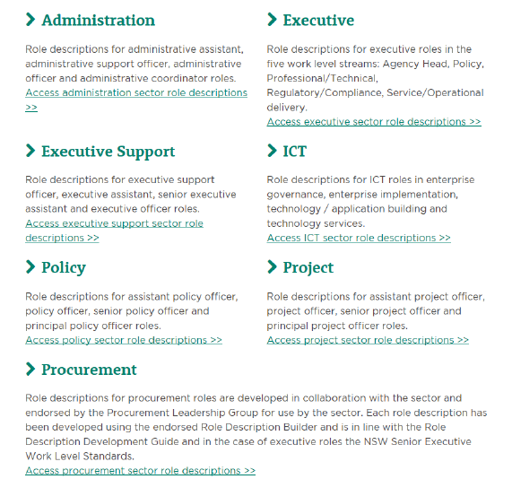
Sector role descriptions library
A large range of sector role descriptions are available for roles that are common across the sector, including roles containing occupation specific capability sets e.g. ICT, Procurement
These roles are published in the online library on the Public Service Commission website

Slide 9
Finance Capability Set

Slide 10
Finance Professionals Capability Set
Designed to be used in conjunction with the NSW Public Sector Capability Framework to support the full range of workforce management activities for finance professionals
Comprises seven capabilities that define additional knowledge, skills and abilities required for roles within the finance profession
The seven capabilities are described by behavioural indicators across five levels of complexity, the behaviours are not exhaustive, but provide an indicative list of the knowledge, skills and abilities expected at each level
Notes:
The Capability Framework applies to all public sector roles, both executive and non-executive. Every role requires, at an appropriate level, all of the capabilities in the Capability Framework, including the Finance ‘Business Enabler’ and also the People Management capabilities for roles responsible for managing others.
When used together, the Capability Framework and the Finance Professionals Capability Set provide a comprehensive description of the capabilities required for successful performance in a finance role e.g. in order to provide strategic advice on the potential financial impact of new policies or programs being considered by government, a role may need highly developed capabilities in analysis (Capability Framework: Think and Solve Problems) as well as expert knowledge of financial trends and forecasting (Finance Professionals Capability Set: Management Accounting).
Most roles only require a subset of the finance professional capabilities, depending on the focus of responsibilities
Specialised knowledge, skills and abilities are also rarely required for either entry level roles or agency head roles. This means that, while the core Capability Framework applies to roles from entry level to agency head, the Finance Professionals Capability Set will generally only apply to roles above entry level but below agency head.

Slide 11
Finance Professionals role descriptions
Selection of each Finance Professionals capabilities should be based on the role’s Primary Purpose, Key Accountabilities, Key Challenges, Key Relationships
As a general guide, no more than 3-5 occupation specific capabilities should be included in a role description, in addition to the Capability Framework capabilities
The person who performs the role may possess other capabilities not included in the role description: however, the role description should include only the capabilities that are fundamentally important for effective performance of the role

Slide 12
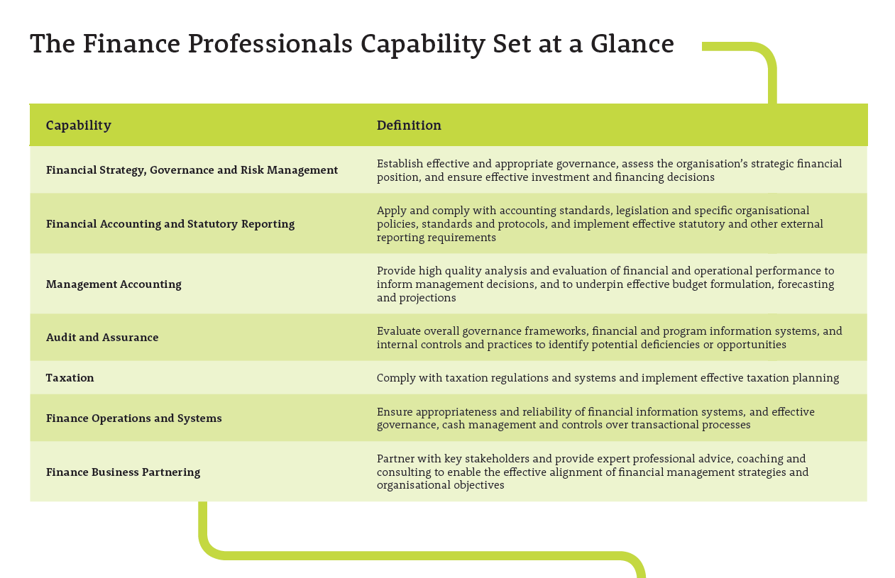
Seven occupation specific capabilities
Notes:
The seven capabilities in the Finance Professionals Capability Set are described by behavioural indicators across five levels of complexity. The behaviours are not exhaustive, but provide an indicative list of the knowledge, skills and abilities expected at each level.
When read collectively, the behavioural indicators provide a reasonable understanding of what a particular level of capability ‘looks like’.

Slide 13
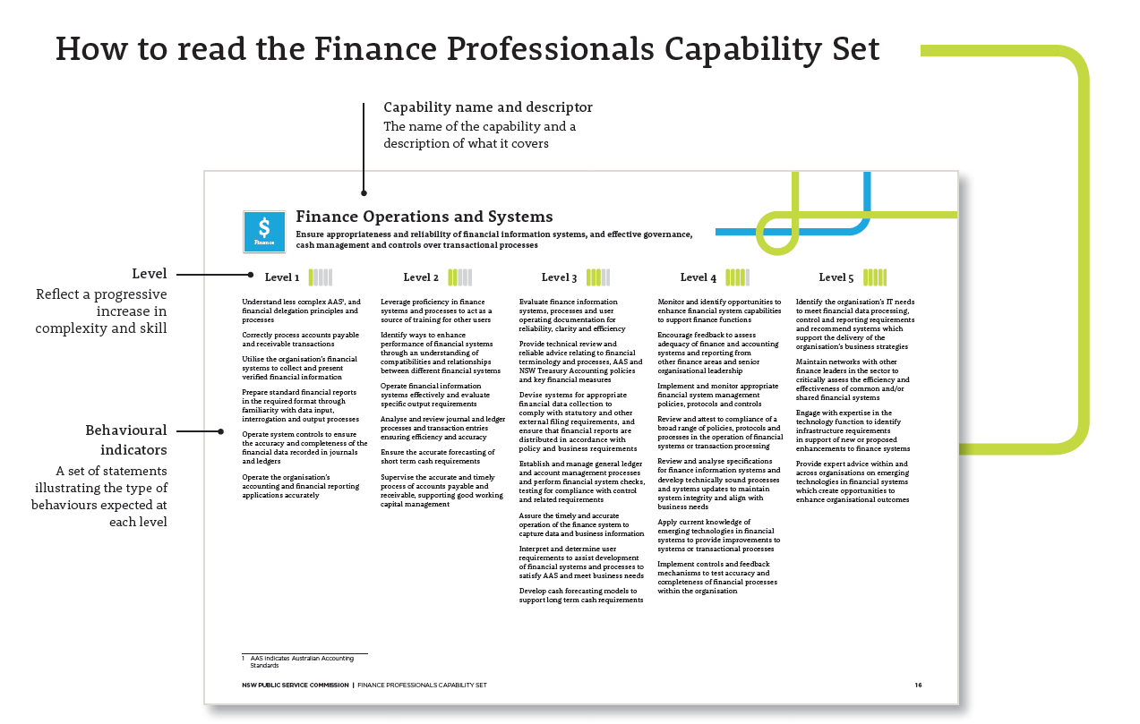
Five levels with descriptive behaviours
Notes:
The levels in the Finance Professionals Capability Set do not correspond directly to classifications or grades
The Capability Framework also has five levels, but these do not correspond directly with the five levels in the Finance Professionals Capability Set
The descriptors for Level 1 of the Finance Professionals Capability Set reflect more complex behaviours than those contained at the Foundational Level in the Capability Framework because the nature of the work undertaken by finance roles requires specialised knowledge, skills and abilities usually developed through tertiary education, training and/or relevant occupational experience

Slide 14
Supporting resources
Finance Professionals Capability Set
NSW Public Sector Capability Framework
Enquiries: capabilityframework@psc.nsw.gov.au

Slide 15
Procurement Professionals Capability Set

Slide 16
Procurement professionals capability set
Designed to be used in conjunction with the Capability Framework to support the full range of workforce management activities for procurement professionals
Comprises ten capabilities that define additional knowledge, skills and abilities required for roles within the procurement profession
The ten capabilities are described by behavioural indicators across five levels of complexity, the behaviours are not exhaustive, but provide an indicative list of the knowledge, skills and abilities expected at each level
Notes:
When used together, the Capability Framework and the Procurement Professionals Capability Set provide a comprehensive description of the capabilities required for successful performance in a procurement role e.g. in order to provide strategic advice on the most cost-effective procurement strategies for a major project, a role may need highly developed capabilities in analysis (Capability Framework: Think and Solve problems) as well as expert ability to interpret markets and their dynamics (Procurement Professionals Capability Set: Procurement Analysis).
The range of workforce management and development activities includes role design and description; recruitment; performance development; learning and development; and strategic workforce planning.

Slide 17
Procurement role descriptions
Selection of each Procurement Professionals capability should be based on the role’s Primary Purpose, Key Accountabilities, Key Challenges, Key Relationships
As a general guide, no more than 3-5 occupation specific capabilities should be included in a role description, in addition to the Capability Framework capabilities
The person performing the role may possess other capabilities not included in the role description: however, the role description should include only the capabilities that are fundamentally important for effective performance of the role

Slide 18
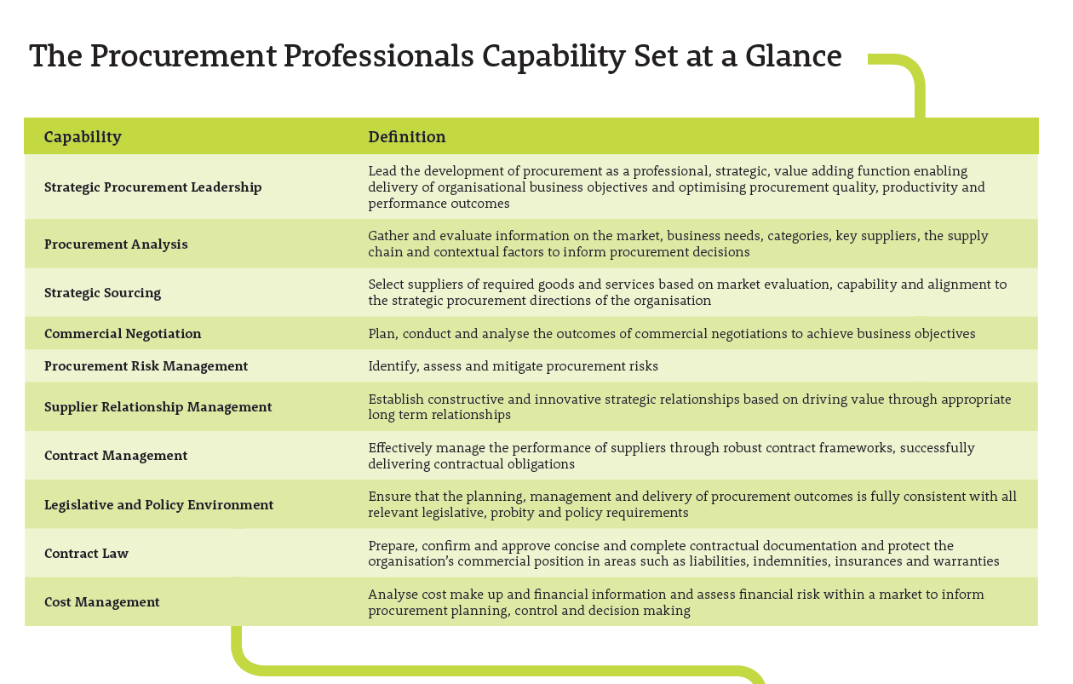
Ten occupation specific capabilities
Notes:
The ten capabilities in the Procurement Professionals Capability Set are described by behavioural indicators across five levels of complexity
The behaviours are not exhaustive, but provide an indicative list of the knowledge, skills and abilities expected at each level

Slide 19
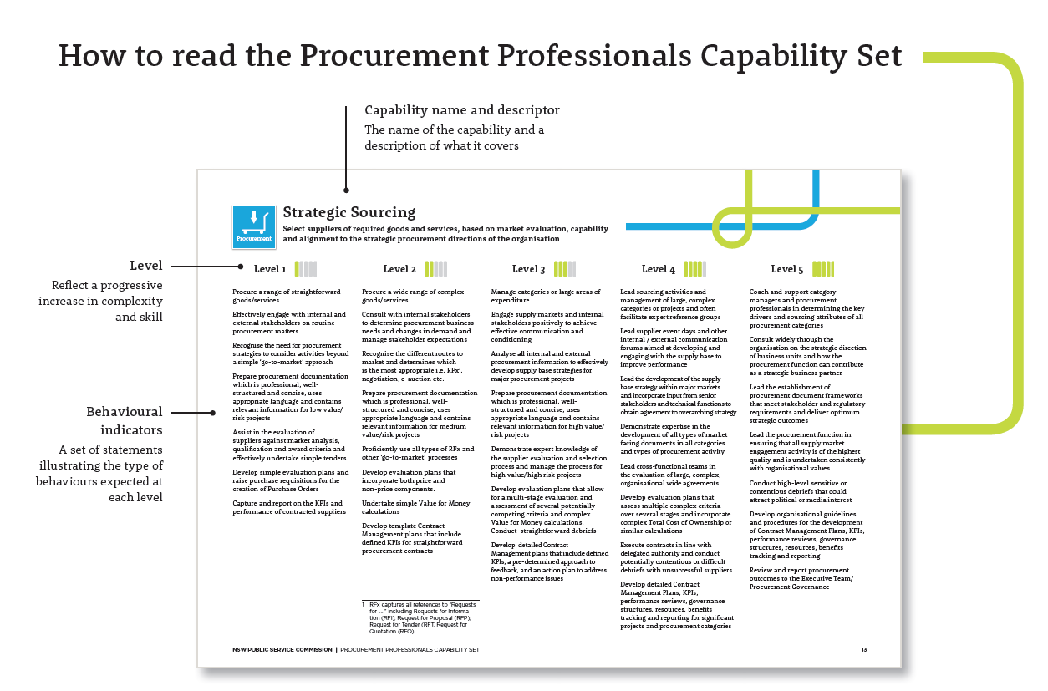
Five levels with descriptive behaviours
Notes:
The Capability Framework also has five levels, but these do not correspond directly with the five levels in the Procurement Professionals Capability Set
The descriptors for Level 1 of the Procurement Professionals Capability Set reflect more complex behaviours than those contained at the Foundational Level in the Capability Framework because the nature of the work undertaken by procurement roles requires specialised knowledge, skills and abilities usually developed through tertiary education, training and/or relevant occupational experience.

Slide 20
Supporting resources
Procurement Professionals Capability Set
Procurement sector role descriptions
NSW Public Sector Capability Framework
Enquiries: capabilityframework@psc.nsw.gov.au

Slide 21
Human Resources Professionals Capability Set

Slide 22
Human Resources Professionals Capability Set
Designed to be used in conjunction with the Capability Framework to support the full range of workforce management activities for human resources professionals
Comprises seven capabilities that define additional knowledge, skills and abilities required for roles within the human resources profession
The seven capabilities are described by behavioural indicators across five levels of complexity, the behaviours are not exhaustive, but provide an indicative list of the knowledge, skills and abilities expected at each level
Notes:
The Human Resources Professionals Capability Set is intended to be used in conjunction with the NSW Public Sector Capability Framework (“Capability Framework”) to support the full range of workforce management and development activities, including role design and description, recruitment, performance development, learning and development, and strategic workforce planning.
When used together, the Capability Framework and the Human Resources Professionals Capability Set provide a comprehensive description of the capabilities required for successful performance in a human resources role e.g. in order to provide strategic advice on the potential workforce implications of new service delivery models being considered by government, a role may need highly developed capabilities in analysis (Capability Framework: Think and Solve Problems) as well as expert ability to examine business problems in workforce terms (Human Resources Professionals Capability Set: Workforce Strategy and Planning)

Slide 23
Human Resources role descriptions
Selection of each Human Resource Professionals capability should be based on the role’s Primary Purpose, Key Accountabilities, Key Challenges, Key Relationships
As a general guide, no more than 3-5 occupation specific capabilities should be included in a role description, in addition to the Capability Framework capabilities
The person performing the role may possess other capabilities not included in the role description: however, the role description should include only the capabilities that are fundamentally important for effective performance of the role

Slide 24
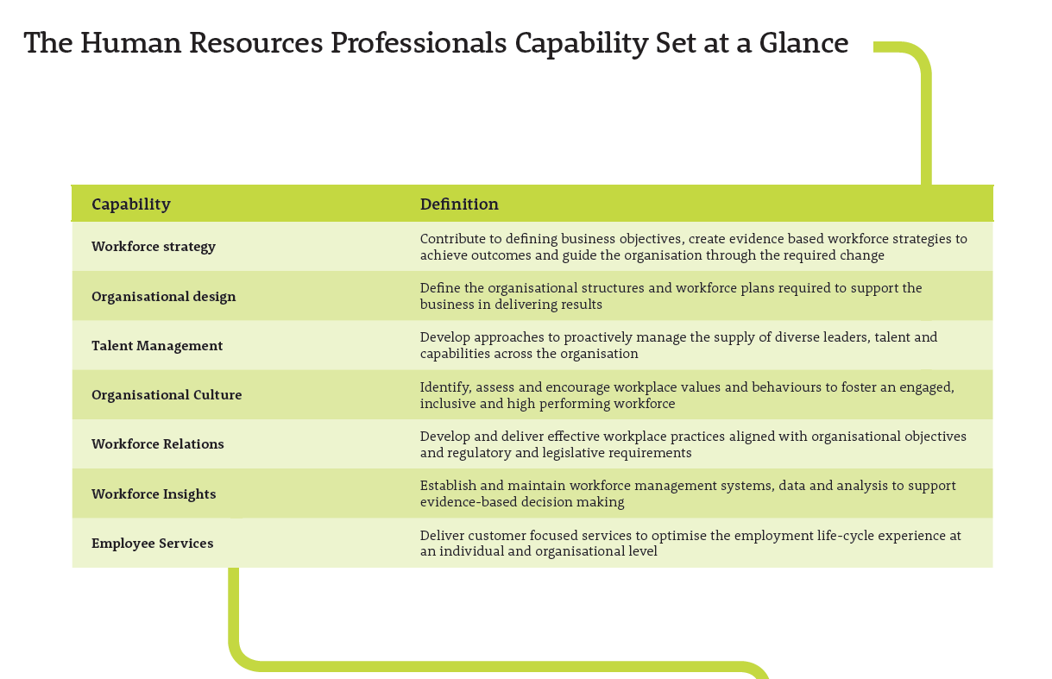
Seven occupation specific capabilities
Notes:
The seven capabilities in the Human Resources Professionals Capability Set are described by behavioural indicators across four levels of complexity
The behaviours are not exhaustive, but provide an indicative list of the knowledge, skills and abilities expected at each level. When read collectively, the behavioural indicators provide a reasonable understanding of what a particular level of capability ‘looks like’.

Slide 25
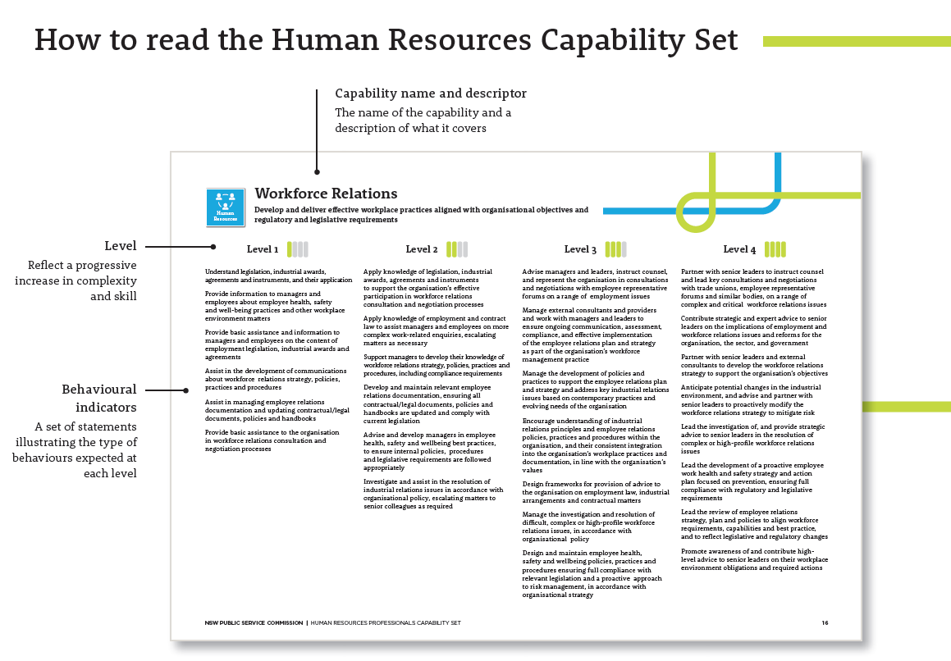
Five levels with descriptive behaviours
Notes:
The levels in the Human Resources Professionals Capability Set do not correspond directly to classifications or grades
The capabilities at level 4 are not intended to apply exclusively to roles at the highest grade in the human resources function
The Capability Framework has five levels, but these do not correspond directly with levels in the Human Resources Professionals Capability Set – the descriptors for Level 1 of the Human Resources Professionals Capability Set reflect more complex behaviours than those contained at the Foundational Level in the Capability Framework because the nature of the work undertaken by human resources roles requires specialised knowledge, skills and abilities usually developed through tertiary education, training and/or relevant occupational experience

Slide 26
Supporting resources
Human Resources Professionals Capability Set
NSW Public Sector Capability Framework
Enquiries: capabilityframework@psc.nsw.gov.au

Slide 27
Information and Communications (ICT)
Professionals Capability Set

Slide 28
Background
The Skills Framework for the Information Age Framework (SFIA) is a world recognised framework
Selected by the ICT and Digital Leadership Group in 2012 as the occupation specific capability set for ICT professionals in the NSW public sector
SFIA is intended to be used in conjunction with the Capability Framework to support the full range of workforce management activities for ICT professionals
The NSW Government is licensed to use SFIA as the sector’s ICT occupation specific capability set
Notes:
The full range of workforce management and development activities include role design and description; recruitment; performance development, learning and development; and strategic workforce planning.
The Capability Framework applies to all public sector roles, both executive and non-executive. Every role requires, at an appropriate level, all of the capabilities in the Capability Framework, including the Technology ‘Business Enabler’ and also the People Management capabilities for roles responsible for managing others.

Slide 29
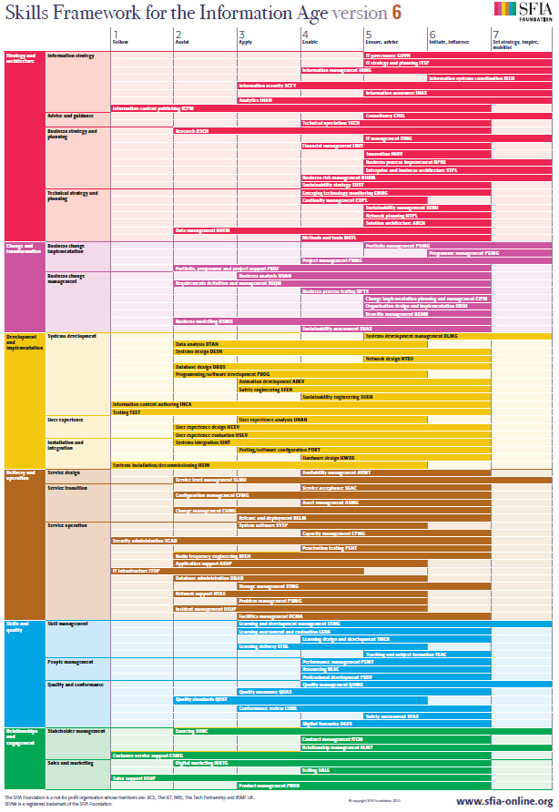
SFIA at a glance
SFIA comprises 97 skills across 6 categories:
Strategy and architecture
Change and transformation
Development and implementation
Delivery and operation
Skills and quality
Relationships and engagement
SFIA version is updated on a regular basis

Slide 30
SFIA STRUCTURE
Each capability (skill) comprises an overall definition and up to seven levels describing how the skill might be exercised
The seven levels of capability do not apply across every skill, reflecting that some skills are required at entry level while others are only required in more senior roles

Slide 31
Applying SFIA in ICT role descriptions
The SFIA applies in an ICT role description when:
the work clearly requires specialised ICT knowledge, skill and/or ability
the specialised ICT work occupies a large part of the role
the job title is strongly associated with the profession, e.g. Systems Administrator, Enterprise Architect
the ‘Primary Purpose’, ‘Key Accountabilities’ and ‘Key Challenges’ contained in the role description indicate a need for ICT capabilities for successful performance of the role

Slide 32
Applying SFIA in ICT role descriptions
Whilst SFIA comprises 97 skills, generally only 3 - 5 SFIA skills are added to an ICT role (in addition to the NSW Public Sector Capability Framework capabilities)
SFIA levels do not correspond directly to classifications or grades and will generally only apply to roles above entry level but below agency head
A SFIA Capability Comparison Guide is available that provides:
an indication of the number of SFIA capability levels (as a range)
an outline of the number of focus capabilities (as a range) at each Clerk Grade/Public Service Senior Executive Band

Slide 33
SFIA and other role requirements
SFIA describes behaviours, not qualifications
If a qualification, professional membership or certification for a particular product or technology is an essential requirement for the role, this remains a prerequisite for employment and should be reflected in the “Essential Requirements” section of the role description

Slide 34
How the Capability Framework and SFIA work together
To avoid duplication, where a skill appears in the SFIA and the Capability Framework, the core capabilities should take precedence.
For example, skills contained in the SFIA that are adequately covered by capabilities from the Capability Framework, include:
IT Strategy and Planning described by the capabilities: Plan and Prioritise, Inspire Direction and Purpose, Work Collaboratively and Communicate Effectively
Performance Management described by the capabilities: Manage and Develop People and Optimise Business Outcomes

Slide 35
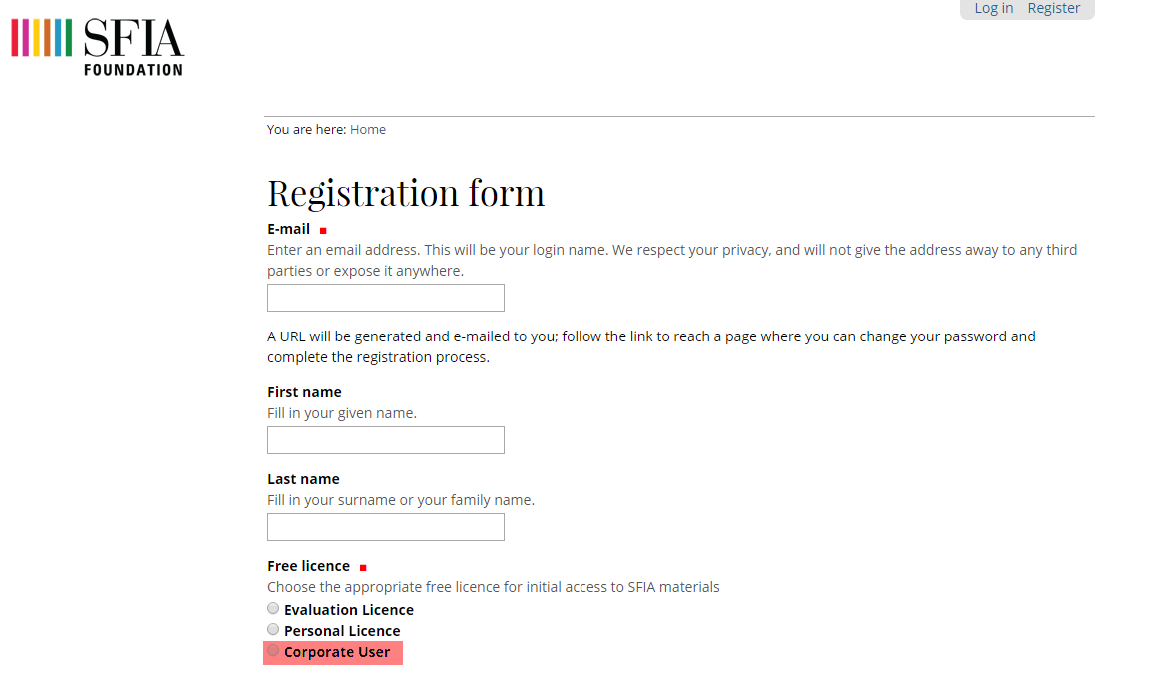
Accessing SFIA
The SFIA Framework can be accessed via the SFIA Foundation website
When registering select ‘Corporate User’ to obtain access

Slide 36
Supporting resources
Sector ICT role descriptions
ICT Capability Assessment Strategy
ICT Capability Framework – An introduction (PPTX 726.7KB)
ICT Capability Comparison Guide (SFIA) (PDF 304.7KB)
NSW Public Sector Capability Framework
Enquiries: capabilityframework@psc.nsw.gov.au

