Slide 1

PMES knowledge sharing event
Driving employee experience during COVID
04 March 2022
PMES Team
  NSW Public Service Commission

Slide 2
Agenda
Part 1 | Time
Welcome | 5
Presentation from eHealth NSW + Q&A | 25
Presentation from NSW Treasury + Q&A | 25
Part 2 | Time
Group discussions | 25
Summary of discussions | 5
Closing | 5

Slide 3
eHealth NSW
Presentation and Q&A

Slide 4



eHealth NSW
Culture and Employee Engagement

Slide 5
Agenda
eHealth NSW Workforce: A snapshot
Our PMES results
Culture Journey
Talent Development
Learning and Development Opportunities
Gender Equality Initiatives
Wellbeing during the pandemic

Slide 6
About eHealth NSW
A digitally enabled health system: integrated, patient-centric, safe, delivering quality health experiences and outcomes
We partner with NSW Health organisations
in the planning, adoption and ongoing development of digital technologies and capabilities that deliver value
Why?
How?
We:
plan and manage ICT investments
maintain policies and standards
design and procure systems
manage implementations and
commission or provide ICT support
services
What?

Slide 7

eHealth NSW Workforce – A snapshot
        Approximately 2043 staff*
        Overall 32% of our workforce is female
        Females account for 44% of employees, and 51% of employees in Tier 1-5 roles
        25% of employees are under 35 years of age, and 14% are over 55
        Employees are engaged under a number of different awards structures, including the health employees’ administrative staff award, the health employees’ computer staff award and the health managers award.
*employees and contingent workers

Slide 8


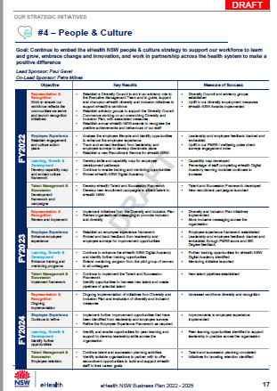
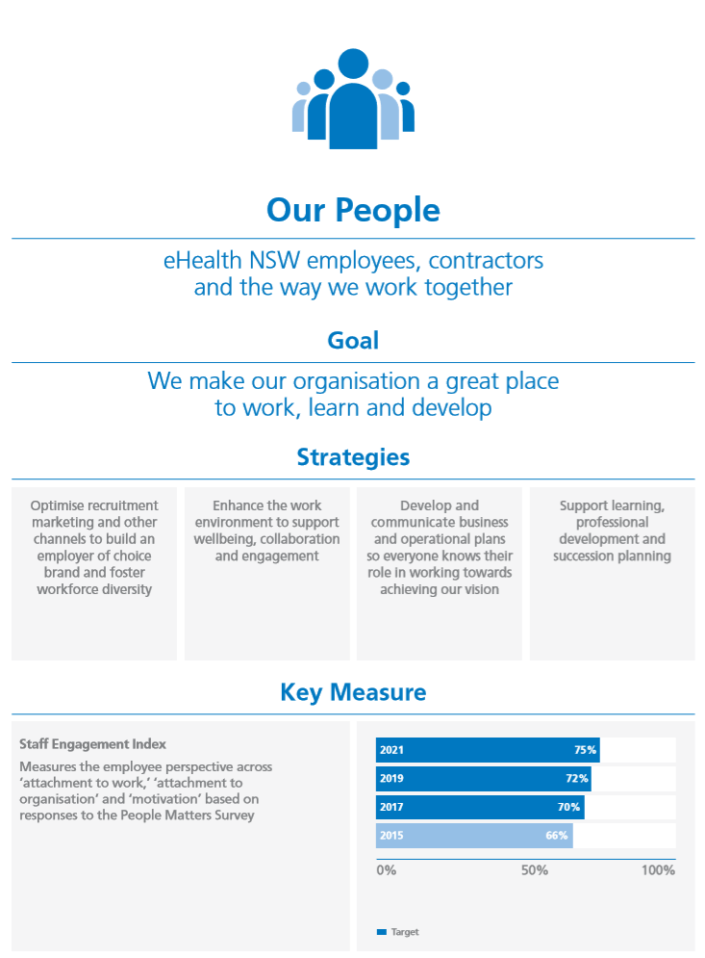
Supporting our people continues to be a key organisational strategy for eHealth NSW
DRAFT
*The eHealth NSW Business Plan is yet to be published – it is currently in consultation phase

Slide 9
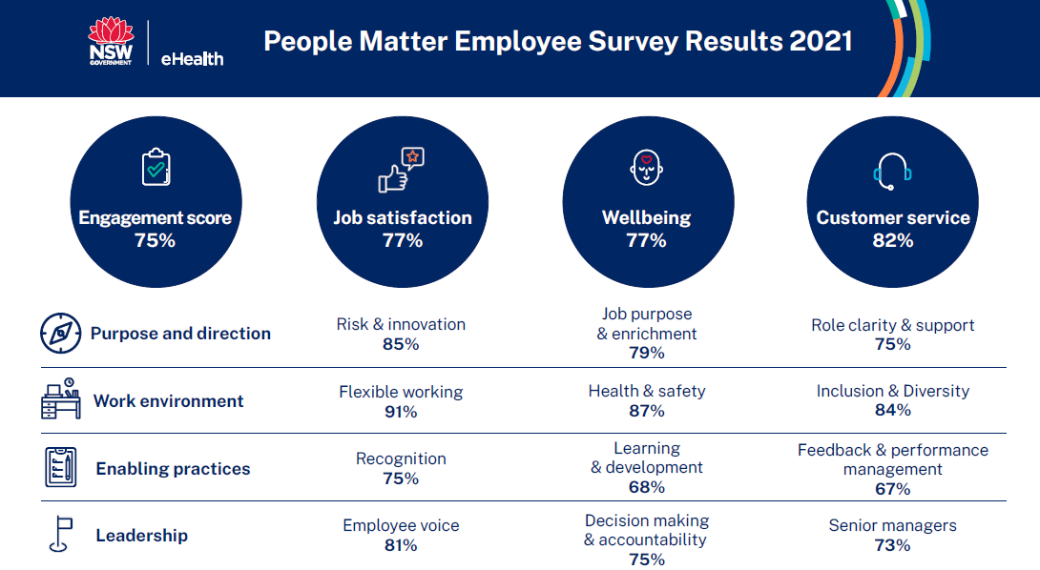

Slide 10
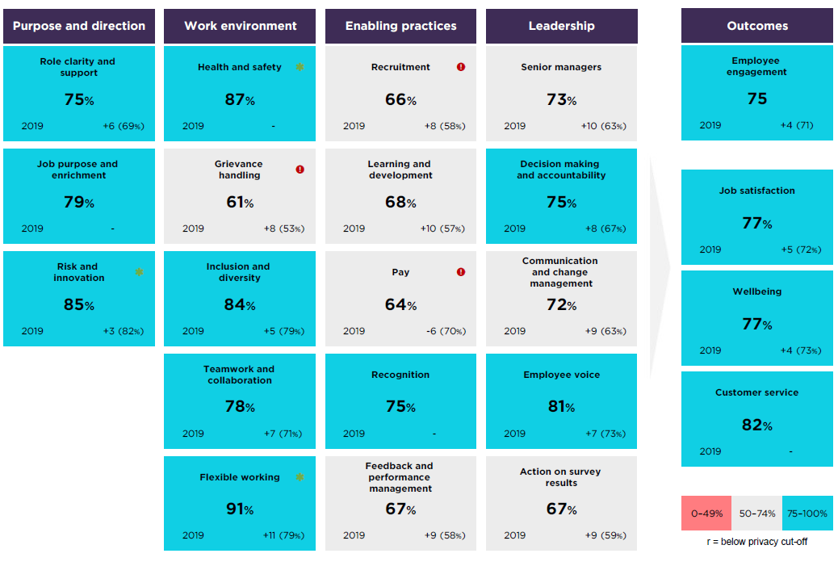
PMES headline results for key topics
+10
+21
+21
+25
+11
+13
+21
+15
+20
+12
+16
+16
+15
+22
+10
Difference from Cluster (NSW Health)
Top 3
Bottom 3
+17
+21
+20
+13
+36
+10
+28

Slide 11
eHealth NSW commenced its culture journey in 2018
Discovery phase
Define the current culture and insights.
Dream phase
Define the desired, aspirational culture.
Design phase
Determine what should be.
Destiny phase
Create and deliver what will be.
2018
2019
2020
2021
Q3
Q4
Q1
Q2
Q3
Q4
Q1
Q2
Q3
Q4
Q1
Q2
Culture Projects
Activated
.
Culture Projects
Implementation Commenced
.

Slide 12

Our culture program targeted all levels of our organisation throughout all phases
Program Activity Example | All Staff | Senior Leaders | Executive Mgt Team
Discovery/Dream/Desire Phases
Undertake Barrett Values Ax to determine desired culture
Develop definitions for desired archetypes
Identify desired behaviours
Determine priority projects
Design Phase
Sponsor and lead a priority project working group
Participate in priority project working groups
Participate in events established as part of the culture program (e.g. trivia)

Slide 13
We also utilise a variety of different channels to engage staff and reinforce our culture program and cultural archetypes
Engagement Opportunity | Channel | Frequency | Target Group
 |  |  | All Staff | Snr Leaders
Chief Executive’s Update | Email (tracking platform) | Fortnightly
Staff Bytes
 | Digital Newsletter (tracking platform) | Fortnightly
Staff Forums | In-person & live-streamed or Teams Broadcast | Quarterly
Senior Leadership Forums | In-person or using Teams/other videoconferencing platform (if externally facilitated)* | Quarterly or as required*
Directorate Town Halls/other meetings | In-person or using Teams | As determined by directorate/team
*Schedule was responsive to organisational needs during height of the COVID-19 pandemic

Slide 14
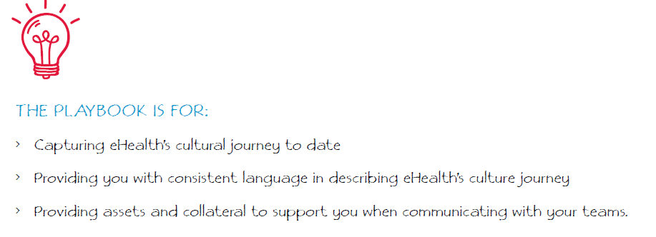

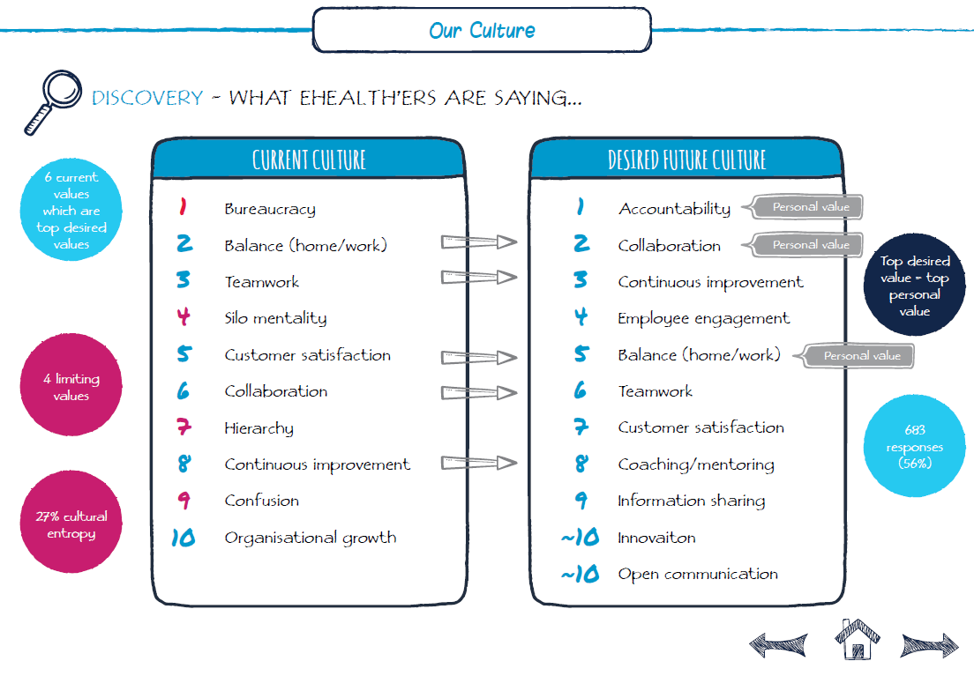
eHealth NSW Culture Playbook

Slide 15
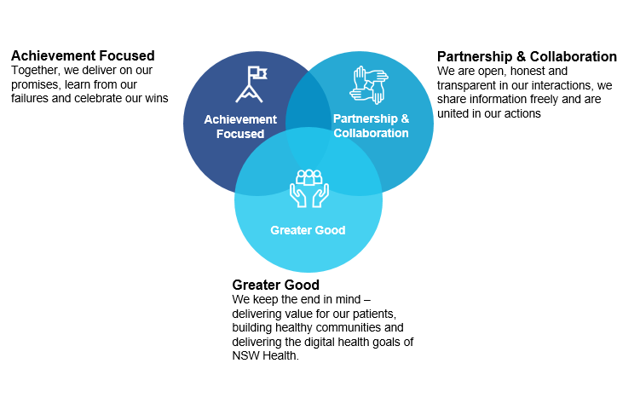
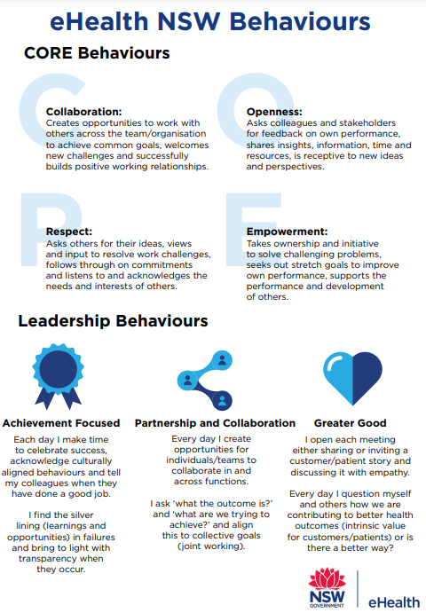

eHealth NSW Cultural Archetypes

Slide 16

Building capability at all levels, across the organisation
    We offer learning and development opportunities that are available to all staff, including:
      eHealth NSW Digital Academy
      Hybrid workplace training, for managers and team members
      Communicating In Culturally Diverse Teams training
      We have tailored training to build leadership capabilities: :
      eHealth NSW Leadership Development Series
      Leadership Development Library aligned to PSC capability framework
      Bespoke 360 feedback development program including a virtual learning program to develop mindsets, beliefs and behaviours of eHealth NSW leaders
    We developed a number of programs to build a diverse and inclusive workforce:
      Women’s Leadership Development Series*
      Women’s Mentoring Program
      Women’s Leadership Community of Practice
      GLIDE+*
*being replaced with new initiatives

Slide 17
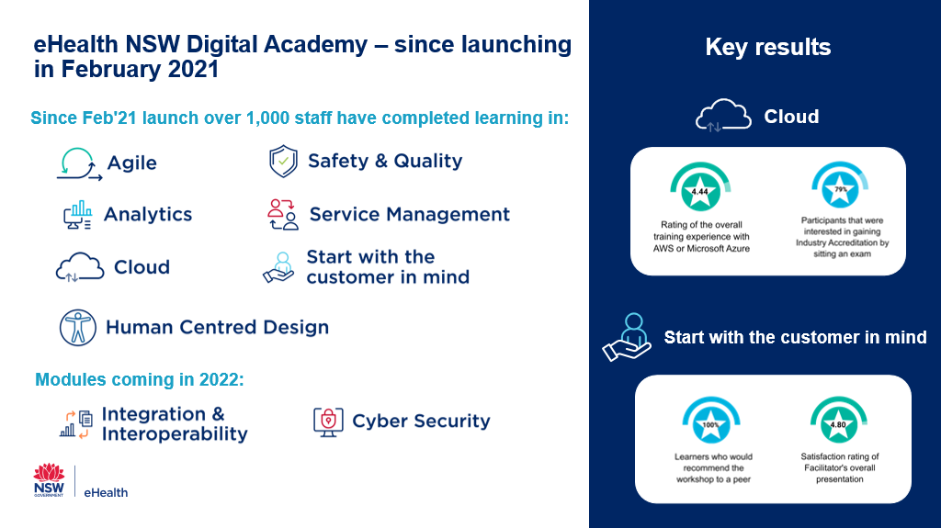

Slide 18

Building a pipeline of skilled staff by targeting different points in a person’s career journey
    eHealth NSW has a number of programs in place, these include:
    Pilot program with Association of Independent Schools NSW to embed digital health in the curriculum
    eHealth NSW Internship program
    ACHSM Internship Program
    NSW Government ICT Graduate Program
    RACMA traineeship program
    eHealth NSW Leadership Development Series
      Leadership Development Library aligned to PSC capability framework

Slide 19
Gender Equality Action Plan Progress
Initiative
Progress
Comments
Gender equality awareness for the senior team
100%
Complete
A professional development program
100%
Complete
Access to internal and external development programs and courses
100%
Complete
Flexible work practices
100%
Complete
Extended leave / return to work support plan
90%
Women's Leadership Community of Practice leading this initiative
Shadow for a day (or longer)
Women's Leadership Community of Practice leading this initiative
25%
Succession Planning
100%
Complete
Review job advertisements
100%
Complete
Increase Networking opportunities
100%
Complete
Establish goals and targets
100%
Complete

Slide 20
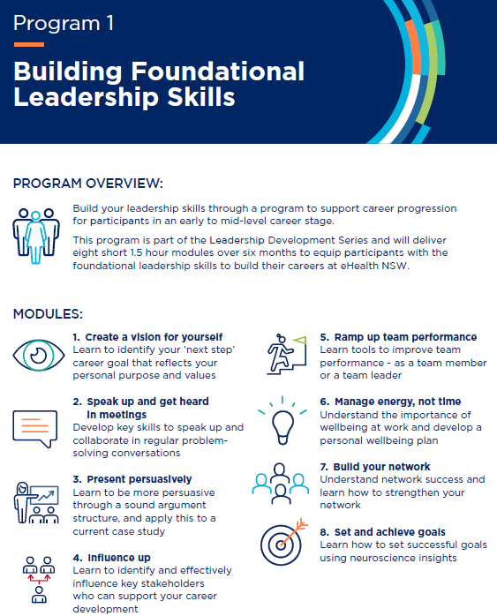
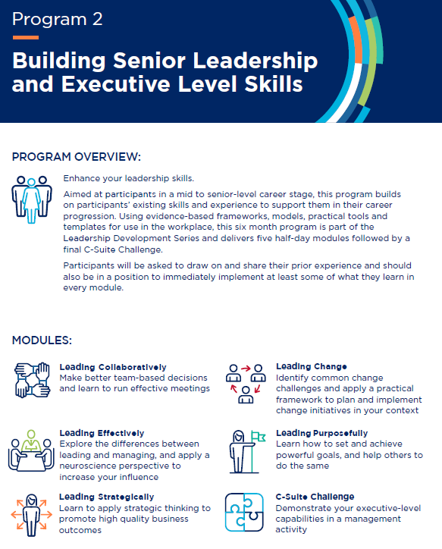
Women’s Development Series

Slide 21
Women’s Development Series Participant Feedback
“This workshop has been a great experience with a lot of tips that you can use immediately that are most importantly simple. Our trainer was exceptional in sharing her stories, research and extensive knowledge of the subject which made the training more easy to retain. It has also been personally motivating because I can see a pathway for growth where before it was difficult to see. Thanks for this opportunity.”
“It has made me reflect on my career and personal goals more and think of a plan. It also gave me the opportunity to meet new great women within eHealth which was great for networking.”
“This was an excellent and well designed course and I would thoroughly recommend it to other women looking to develop their leadership capability”
“I think having a support network of likeminded aspiring female leaders has been wonderful and comforting. It's given me new insights and opened up doors to collaborate beyond my directorate.”

Slide 22

Leveraging our organisational culture, our strengths and relationships helped us to navigate the COVID-19 pandemic and other challenges
‘In crisis it’s culture that really determines brand, because culture will determine how you handle the crisis and ultimately how you are perceived and remembered by the public.’
Dixie Gillaspie, Entrepreneur, 2008
Source: https://www.entrepreneur.com/article/312534

Slide 23
Monitoring and promoting wellbeing during the pandemic
    We deployed several wellbeing pulse check surveys:
      May 2020 (400 responses)
      October 2020 (844 responses)
      April 2021 (525 responses)
    We pivoted a number of our usual activities so they could be held virtually:
      Forums/Events: Staff Forums; Senior Leadership Forums; Trivia
      Training: Team strengths, Growth & Development Training for Managers; Leading the eHealth way; Coaching for managers
    We actively promoted health and wellbeing initiatives:
      Via Staff Bytes and in CE Updates: Communications drew on our cultural archetypes to balance an acknowledgement of challenges while inspiring people to continue their work to positively impact the health system
      Staff Forums and Senior Leadership Forums focused on wellbeing and connection
      The People & Culture team undertook domestic awareness training to recognise warning signs in staff

Slide 24
Thank you

Slide 25
NSW Treasury
Presentation and Q&A

Slide 26

PMES
Treasury’s Journey to World Class

Slide 27
It’s been a progressive journey….
2021
2020
2019
65%
69%
.
72%

Slide 28
Actions we took
Shifted engagement from an annual event to how we do things at Treasury
Secretary set a clear goal of 75%. Senior Leaders to be more visible and drive engagement
Focused on building our strengths (SWOT)
Created leadership awareness and accountability to drive engagement locally
Created two distinct action plans – TSY Wide and Divisional Wide
Regularly updated employees on actions on results
Conducted listening circles with employees to further understand priority topics

Slide 29
Conducted a SWOT analysis to get a complete picture
Strengths
Look at high scoring areas
Look at most improved questions
S
W
Weaknesses
Look at lowest scoring topics
How do scores differ from the parent and sector results?
O
T
Opportunities
T
Look at the drivers of engagement
Drivers are survey question that has a larger impact on employee engagement compared to other survey questions
Drivers should be factored when action planning
.
Threats
What is going on that might impact the scores (lockdown/home schooling, high workloads?)

Slide 30



Actions to improve leader awareness
Leadership Training
We added a session on how/why leaders influence engagement in existing leadership programs to show alignment (Gallup Research)
Trained leaders on how to draw insights from report
Leader Communication on Action
Leaders provided updated on actions taken
WHY
Why did we do the survey
DISCUSS
What do these results mean to our team
SELECT
What are three things we want to focus on
PLAN AND EXECUTE
Brainstorm Possible actions
Follow up
Leader Accountability
Made leaders accountable for delivering their local action plan and provide status updates
People Committees to support actions

Slide 31
People Management and Leadership Impacts Engagement
 | Managing (Systems, Process) | Leading (Behaviour) | Engagement Outcome
Role Clarity and Support | Share tools, documents and resources for success. (strategic documents, departmental goals, challenges and opportunities) | Communicating a clear strategy & direction Share the vision: Connect to the vision of the team and strategic direction of Treasury | I understand what is expected of me to do well in my role (1a) My job gives me a feeling of personal accomplishment (1e) My organisation meets the needs of the people of NSW (7i) My manager communicates effectively with me (5c)
Engage | Create forums for discussion and collaboration: Schedule 1:1 meetings, team meetings, team social connection etc. | Collaborate and Communicate for success: Listen, inspire, give feedback, discuss PMES results and goals. Build Trust | I am satisfied with my job (1g) My manager encourages and values employee input (5d) My workgroup works collaboratively to achieve its goals (2b)
Develop | Goal Setting: Set PDP goals, KPI’s etc aligned to strategic direction. Establish an individual development plan and action it Complete Talent Reviews | Coach and motivate for development: Have development, talent and career related conversations. Give feedback on performance | I am provided with the support I need to do my job well (1b) My organisation is committed to developing its employees (7e) I have a performance and development plan that sets out my individual goals (3a) My manager provides recognition for the work I do (5g)
Onboard & Offboard | Logistical and administrative process for successful onboarding/offboarding. | Set tone for success/desired culture and vision at onboarding. Offboard successfully for alumni relationship/ support Treasury brand externally | I have the tools and technology to do my job well (1c) I would recommend my organisation as a great place to work (7j)
Wellbeing | Offer flexibility, leave management, EAP, work life balance options. | Role model and coach for resilience and wellbeing | I can keep my work stress at an acceptable level (1h) In general, my sense of wellbeing is…(1l)
Diversity and Inclusion | Ensure all recruitment and retention strategies reflects Premier's priorities for Treasury’s diversity goals. Ensure all systems and processes are inclusive. | Role model and coach inclusive behaviour. Manage non inclusive behaviour. Champion the Diversity & Inclusion strategy | My organisation respects individual differences (8a) I can speak up and share a different view to others in my organisation (8c) My manager involves my workgroup in decisions about our work (5e)

Slide 32
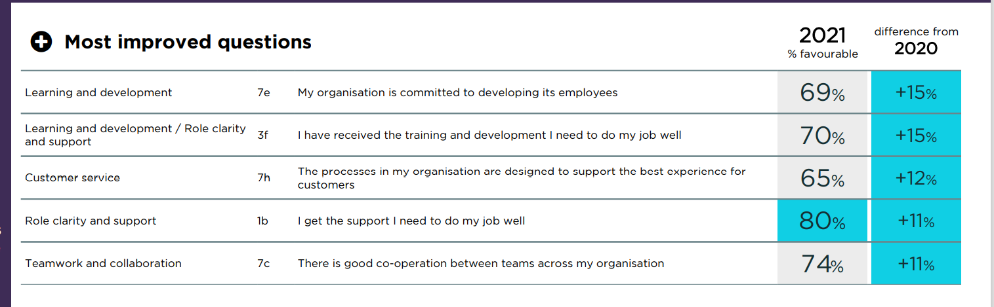
Most improved scores

Slide 33
Where to from here?
A number of proposed actions to consolidate and drive attachment
72%
(1) Treasury Action Plan | (2) Local Action Plans | (3) Feedback
LT to drive overall approach Continue Leadership Development Improve Learning and Development Opportunities Review Recruitment process and candidate and employee experiences Review Negative Workplace Behaviours | People leaders to drive team action plans Continue local action plans Continue engagement and action by people committees | Recognise employees who are actively championing engagement Invite people committees to present to LT on approach Showcase through staff communication
75%

Slide 34

Business Actions – Rhett Gibson Director - Budget Planning and Analysis

Slide 35
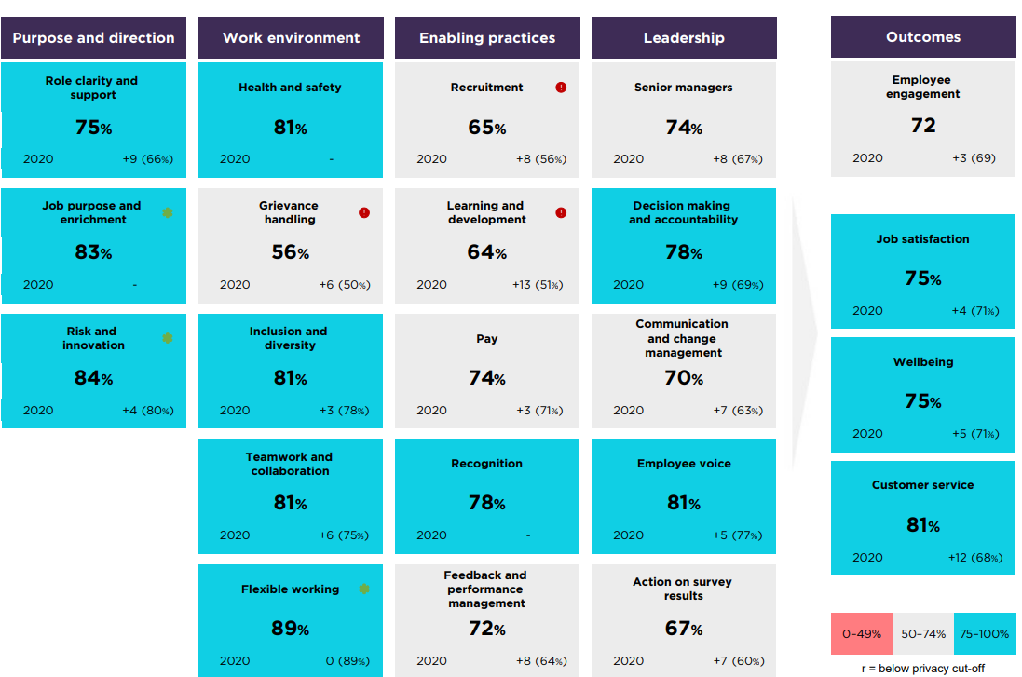
STRENGTHS
OPPORTUNITY AREAS
We have a strong sense of purpose and direction, however the focus should be on continuing on Leadership Development and supporting Enabling Practices

Slide 36
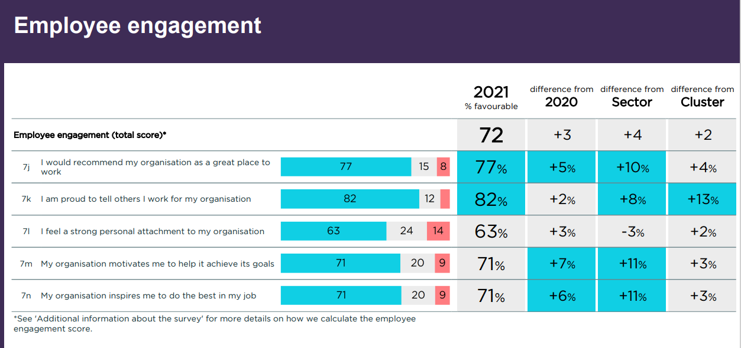
Employee Engagement at a glance
All employee engagement indicators have improved with personal attachment lagging slightly
82% of Employees are proud to tell others they work at NSW Treasury, but 63% feel a strong personal attachment to the organisation. 19% variation
We know that people attach emotionally/personally when they
feel valued
feel listened to
feel that they can grow and develop
feel that they are recognised for their work
This requires significant influence from their leader
Pride and advocacy remains strong with 77% recommending TSY as a great place to work and 82% proud to work at TSY

Slide 37
End of presentations and Q&As
1

Slide 38
Group discussions
2

Slide 39

Group discussions (20 minutes)
What’s your agency’s approach to PMES and employee experience more generally? Is your approach similar or different to the presenters’?
What actions/improvements has your agency been implementing to address your priority areas?
When addressing your priority areas, what useful resources have you come across that you can share with others in the group?
Sharing your ideas on Menti (Code:1490 9887)
Refer to the prompts if you are unsure how to answer a question.
Move between questions in your own time.
Multiple entries. Submit one point at a time.

Slide 40

Closing
Please contact us at
employeesurvey@psc.nsw.gov.au
if you need any assistance

